Slide 1
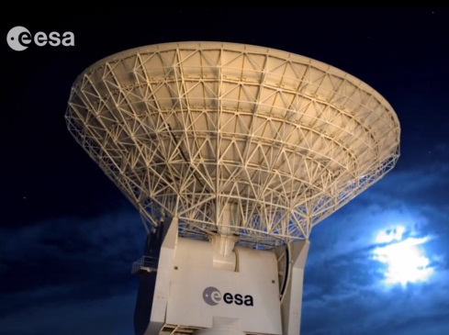
ESA's Ground Station Network
Prospects for operations
of the Lagrange missions
S. Kraft OPS-L , K.-J. Schulz OPS-GS
08/03/2017

Slide 2
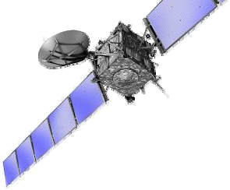


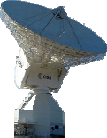

Typical ground segment overview
ESOC/MOC
Mission Operations Centre
ESTRACK
SIM
S/C Simulator
MCS
Mission Control System
ECC
ESTRACK
Control Centre
WAN
SOC
Science Operations Centre
FDS
Flight Dynamics System
MPS
Mission Planning System
DDS
Data Disposition System
Scientific Mission Planning
Instrument Command Requests
Science Data Archive & Processing
User

Slide 3
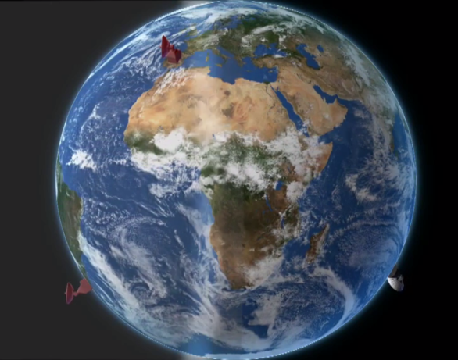
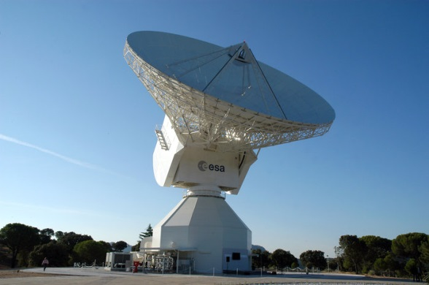
ESTRACK – European Space Tracking
Core elements of the network
  35m deep space antennae located in
    DSA 1: New Norcia (Western Australia)
      S/X-Band ↑ & S/X-Band ↓
    DSA 2: Cebreros (Spain)
      X-Band ↑ & X/K/Ka-Band ↓
    DSA 3: Malargüe (Argentina)
      X/Ka-Band ↑ & X/K/Ka-Band ↓
  Various 12, 13 and 15m class antennas used for S/X-Band LEOP, near Earth and Earth Observation missions, e.g.
    Kourou (French Guayana)
    Kiruna (Sweden)
  One 5.5m antenna used for launcher tracking
CEBREROS 35 m

Slide 4
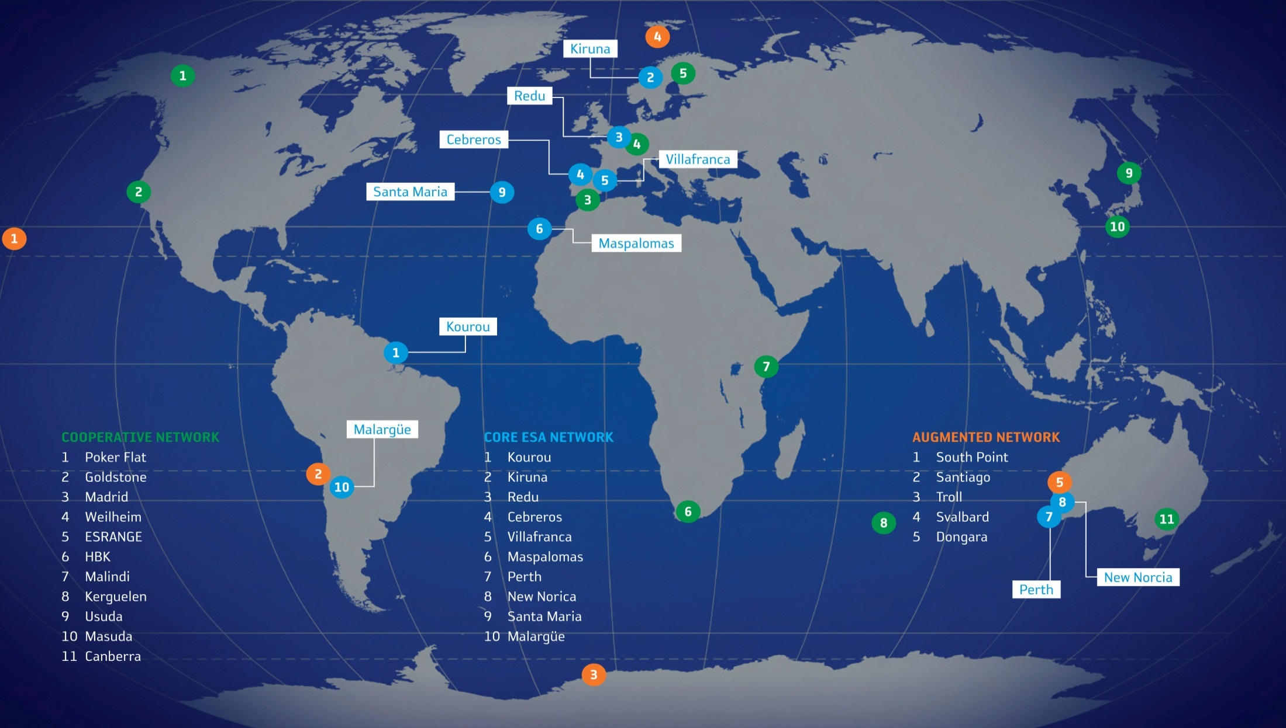
ESTRACK locations

Slide 5
Considerations relevant to L1 / L5 missions
Around the clock coverage
High availability (95 to 99%)
Low latency in delivering of the products (15 minutes to 1 hour)
Preliminary studies identified X-Band as candidate on the basis of
  Good coverage around the world, and also specifically within ESTRACK
  Performance reasonably maintained at large availability even at 99%
  Adequate downlink bandwidth available (10MHz per channel) and no medium term risks of spectrum congestion
  Ground station would support dual polarisation
  Availability of several baselines for Delta DOR tracking, especially interesting for the L5 mission, during the cruise phase
  If large rate traffic could be identified with reduced availability and coverage, Ka-band could also be considered

Slide 6
Typical clear sky performance & improvement
Ka Cryo-feed (future)
Ka-Band G/T 35m
~2.5dB
X Cryo-feed (future)
~1dB
X-Band G/T 35m
S-Band G/T 35m
X-Band G/T 15m

Slide 7

Considerations relevant for L1 / L5 missions
Assume full use of ESOC for ground segment and operations services
  All missions operations phases including preparation
  Strong experience in similar missions
  (LisaPathfinder – L1, many other interplanetary missions)
  Can use both 15m and 35m antennas
  Consider splitting of traffic low rate/latency and high rate/medium latency
Coverage incomplete by ESTRACK for L1/L5
  Antenna services from international partners
  expected to be required
  ESTRACK specific “pacific gap” could be filled by
  NASA/JPL Goldstone or Canberra
  Alternatively build project specific terminals

Slide 8
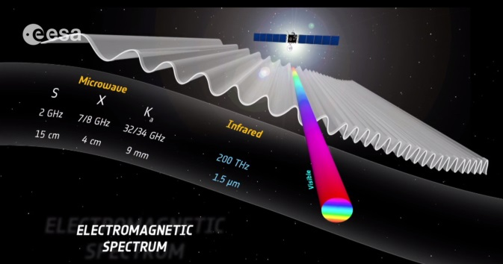
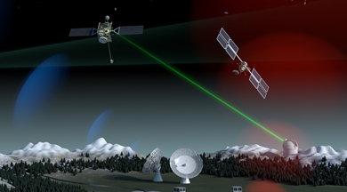
Deep-space Optical Communication
Improve data volume by Optical Direct To Earth (DTE) communication assuming lower availability and higher latency
  Ultimate goal to improve future deep space
  communication for promising cases
  (100 Mbps @ 1 AU)
  Enables novel science missions,
  e.g. planetary hyper-spectral imaging
  High Photon Efficiency (HPE): 1 Photon per Bit
Such optical communication systems require
  15-30 cm onboard terminals (35-50 kg, 100W)
  4m antenna for Moon or Lagrange missions
  12m antenna for Mars or Jupiter missions

Slide 9
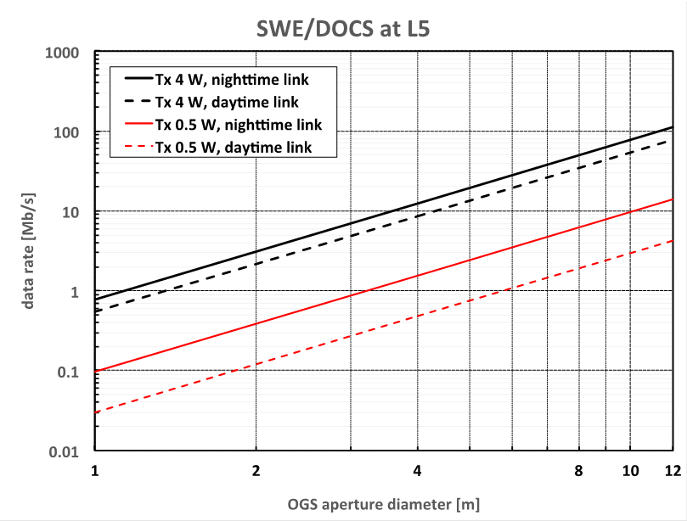
Deep-space Optical Communication System (DOCS) In-Orbit Demonstration (IOD)
Demonstrate deep space optical communication from 1 AU (150 Mkm) distance
  If successful can enable secondary scientific objectives of the SWE L5 mission
Baseline Design (expectation)
  CCSDS High Photon Efficiency (HPE) standard (as on NASA/Psyche mission)
  10 Mbps with 4m ground terminal (scalable to higher data rates with larger ground terminal)
  Reception benefiting from small sky background due to geometry of L5 (60 deg)

Slide 10
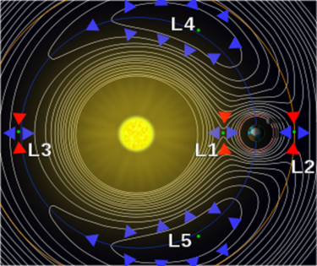
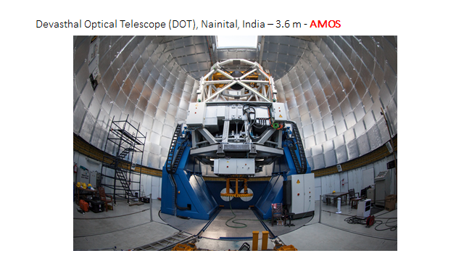
Deep-space Optical Communication System (DOCS) In-Orbit Demonstration (IOD)
Onboard Terminal Design
  20 cm onboard terminal with fine pointer only (no coarse pointer needed as spacecraft pointing is already very precise and stable for instrument operation)
  4W laser transmitter
Ground Terminal Design
  4m optical antenna for day and night operation
  Photon counting receiver
  5 kW uplink beacon

Slide 11
Conclusions
ESOC/ESTRACK can support SWE L1/L5 missions
  Planned developments can offer additional bandwidth to relax S/C communication system
  Required antenna time for L1/L5 missions to be allocated in addition to current ESA missions scheduling
  Consolidation of data rate, availability and latency requirements (multiple classes of links linked to either real time or science purposes)
  Establishment of cooperation agreements with other agencies recommended to meet required coverage, availability and latency requirements
  Optical link considered (resources permitting) as technology demonstration
  Additional scientific benefits to be assessed
  (2 Mbps-average-scenario equivalent to ~ 180 Gb per day)

Slide 12


THANK YOU
swe.ssa.esa.int
http://www.esa.int/Our_Activities/Operations/Estrack
www.esa.int

